Slide 1
Digital Portfolio
STUDENT NAME: B.Gopika
REGISTER NO AND NMID: 36724U09015 AND astvu36736724u09015
DEPARTMENT:BCA (Bachelor of computer application)
COLLEGE: COLLEGE/ UNIVERSITY: Global college of arts & science AND Thiruvalluvar university

Slide 2
PROJECT TITLE
Digital Portfolio

Slide 3


AGENDA
Problem Statement
Project Overview
End Users
Tools and Technologies
Portfolio design and Layout
Features and Functionality
Results and Screenshots
Conclusion
Github Link
3/21/2024 Annual Review

Slide 4

PROBLEM STATEMENT
Many students and professionals face challenges in presenting their skills and achievements effectively. Traditional resumes often lack visual appeal and interactivity, making it difficult for recruiters or employers to fully understand an individual’s capabilities. This project addresses the need for a visually engaging and easily accessible platform to showcase one’s work, skills, and achievements.

Slide 5

PROJECT OVERVIEW
This project is a personal portfolio website designed to highlight my skills, projects, and accomplishments in an attractive and interactive format. It serves as a digital resume, allowing visitors to easily navigate and explore my profile, work samples, and contact details. The goal is to create a strong online presence and leave a positive impression on potential employers and collaborators.

Slide 6

WHO ARE THE END USERS?
The portfolio website is beneficial for:Recruiters and Hiring Managers evaluating my skills and projects.Teachers and Mentors assessing academic or professional progress.Peers and Collaborators who want to connect or work on projects.General Visitors interested in learning more about my expertise.

Slide 7

TOOLS AND TECHNIQUES
Frontend: HTML, CSS, JavaScriptFrameworks & Libraries: Bootstrap (or React if used)Design Tools: Canva / Figma (for banners and visuals)Version Control: Git, GitHubHosting: GitHub Pages / Netlify

Slide 8
POTFOLIO DESIGN AND LAYOUT
The website is designed for simplicity, responsiveness, and visual appeal.Home: A welcoming banner with name and tagline.About: A section introducing me, my background, and interests.Skills: List of technical and soft skills with progress bars or icons.Projects: Cards or grids showcasing previous projects with links to live demos or GitHub repositories.Contact: A form for visitors to reach out via email or social media.Color Scheme & Typography: Clean, modern colors with readable typography to enhance user experience.
8

Slide 9
FEATURES AND FUNCTIONALITY
Responsive Design: Works on mobile, tablet, and desktop.Interactive Navigation: Smooth scrolling and menu links.Project Showcases: Cards with hover effects and GitHub/live project links.Contact Form: Allows users to send inquiries directly.Social Links: Easy access to LinkedIn, GitHub, and other profiles.

Slide 10

RESULTS AND SCREENSHOTS
The final portfolio is a visually appealing, easy-to-navigate website that effectively presents my skills and achievements.(Here you would add screenshots of your Home page, Projects section, and Contact page.)
3/21/2024 Annual Review
10

Slide 11
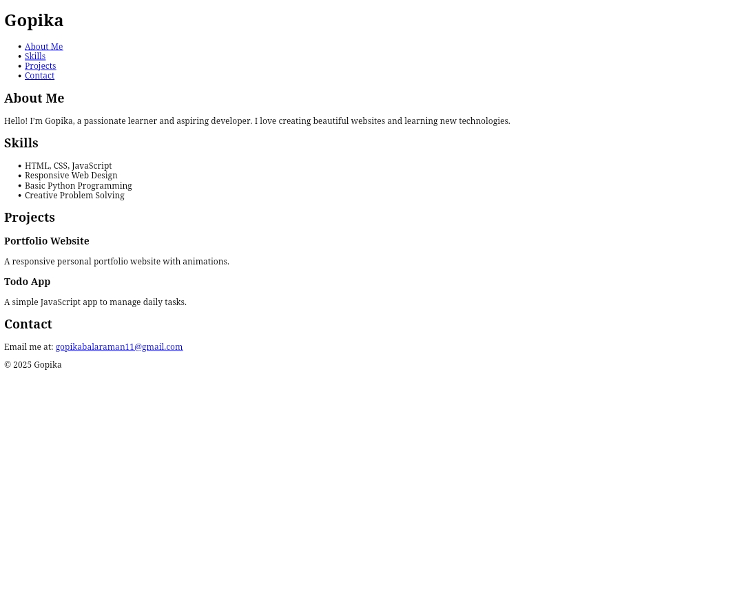

Slide 12
CONCLUSION
This portfolio website successfully demonstrates my abilities, making it easier for recruiters and collaborators to view my work. It enhances my personal branding and online presence.Future Improvements: Adding features like a blog section, animations, and a dark/light mode toggle for better user experience.
12

Slide 13
https://github.com/gopikabalaraman11-sys/Gopika.git

Slide 14


